Slide 1

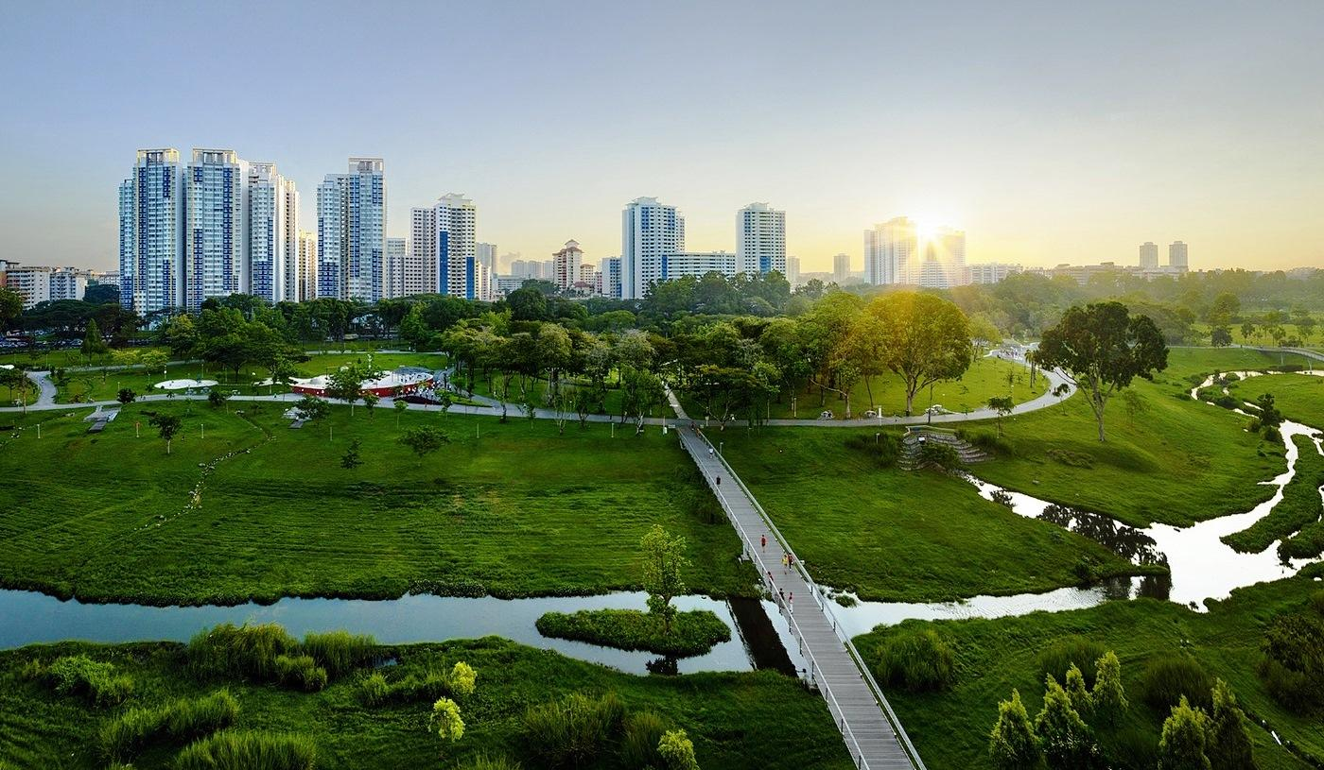
Team: Shingles All The Way Team Members:
Pulkit Varshney (114709284)
Pratik Thorwe (113221363)
Saurabh Parekh (114356444)
Purva Mhasakar (114354303)

Slide 2




Aim
ENHANCE INCLUSIVE AND SUSTAINABLE URBANIZATION
REDUCE THE ADVERSE PER CAPITA ENVIRONMENTAL IMPACT OF CITIES
SUPPORT LEAST DEVELOPED COUNTRIES IN SUSTAINABLE AND RESILIENT DEVELOPMENT
IMPLEMENT POLICIES FOR RESOURCE EFFICIENCY AND DISASTER RISK REDUCTION

Slide 3
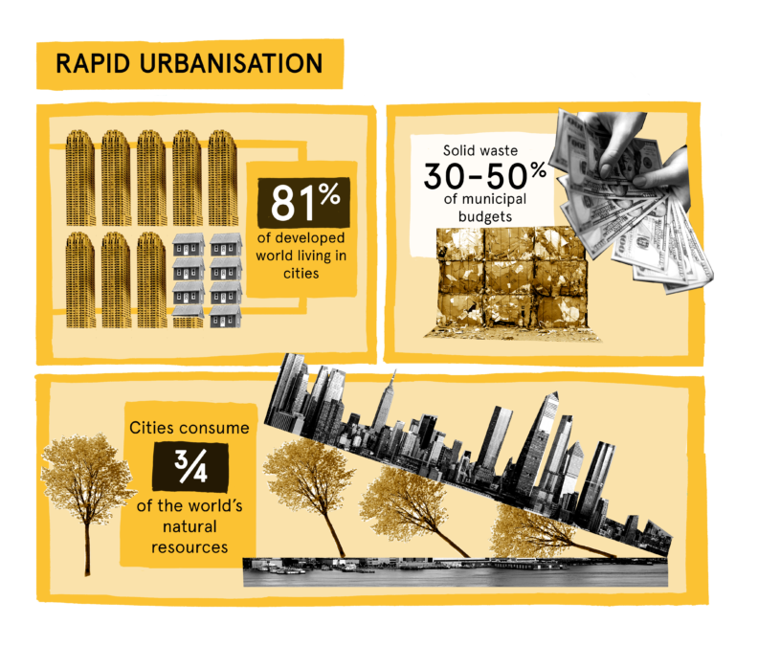
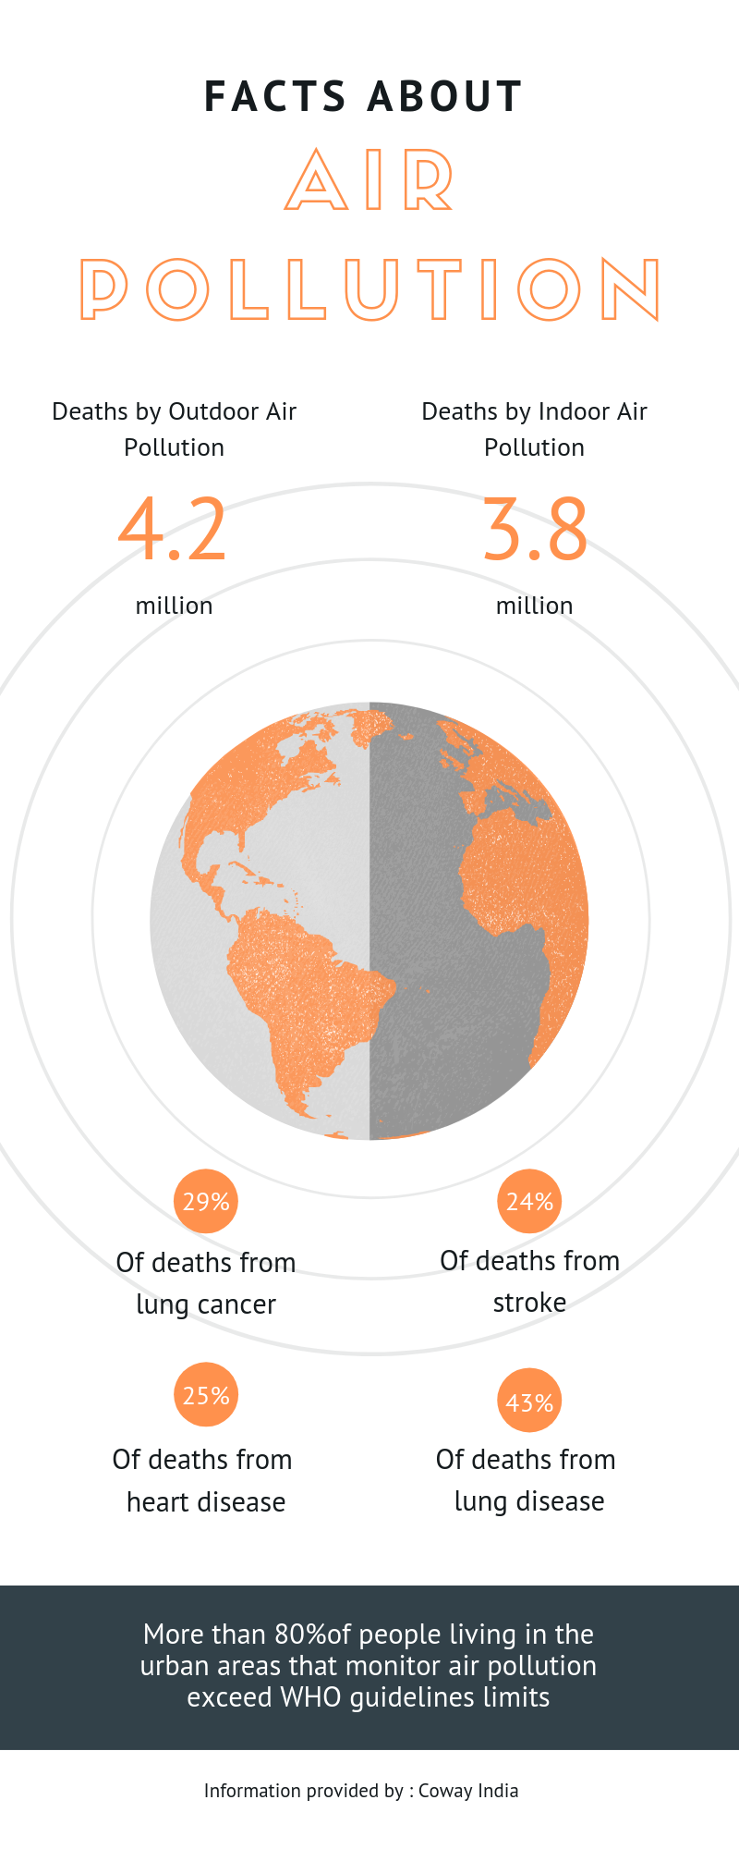
Why do we care
3.9 billion people live in cities globally. 5 billion people will live in cities by 2030.
Cities occupy 3 percent account for 60–80 percent of energy consumption and 75 percent of carbon emissions.
By 2050, about 70% of the world’s population is expected to live in urban areas
Quote :

Slide 4
Background

Slide 5
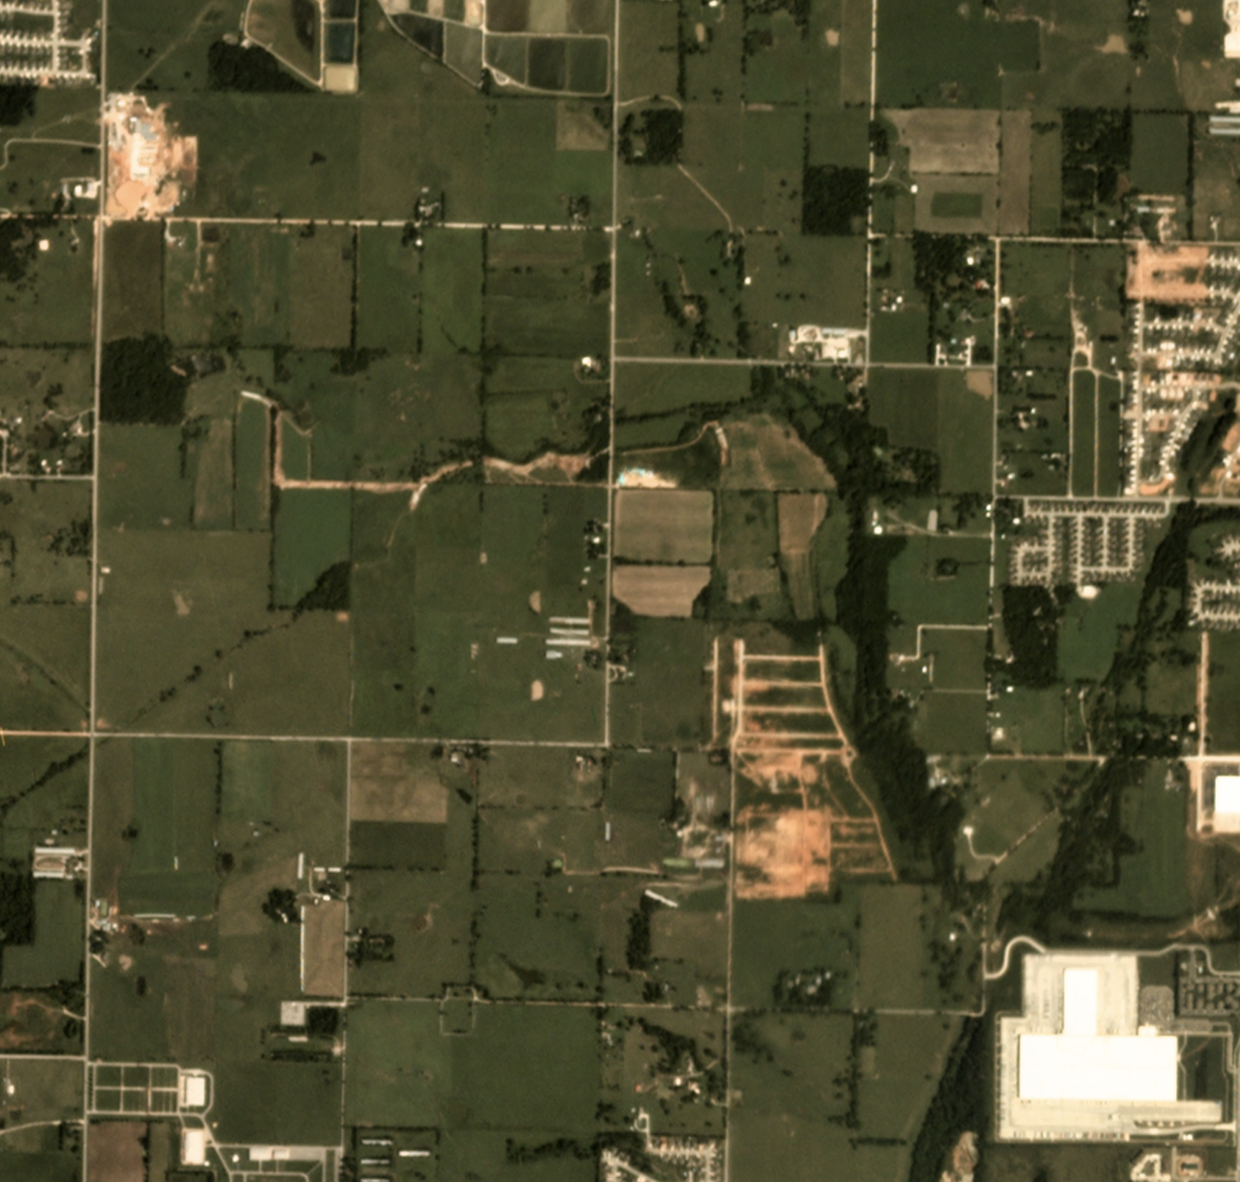
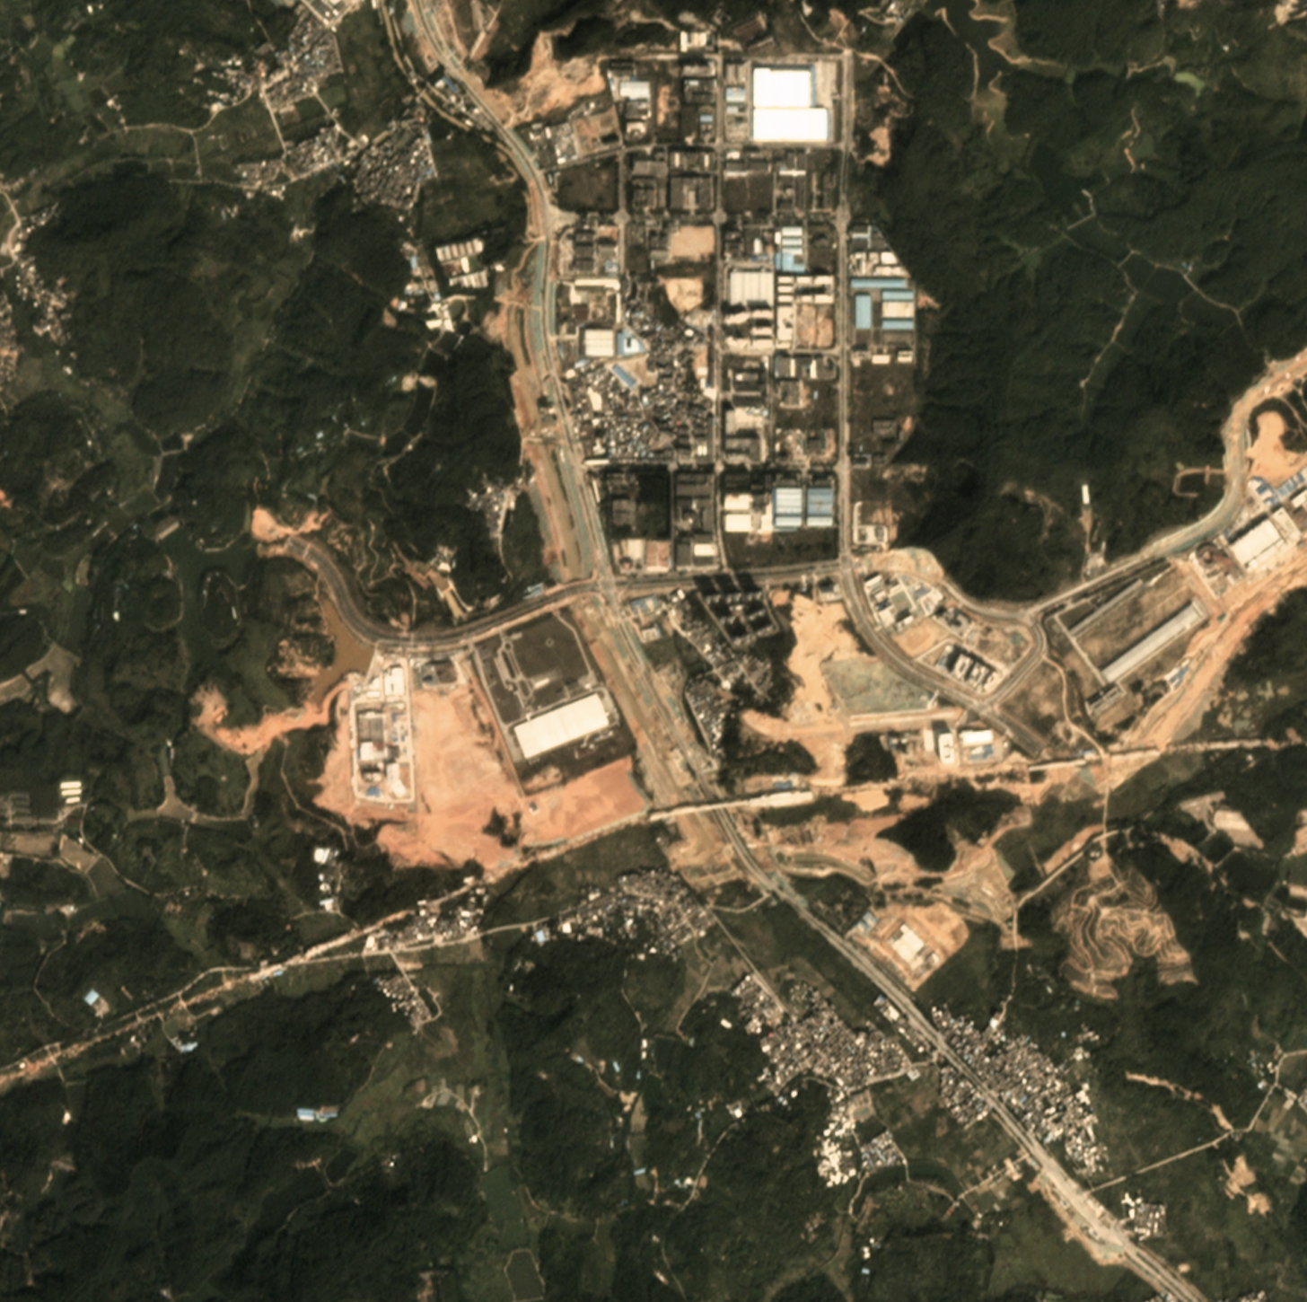
About Dataset
Source: https://databank.worldbank.org/source/world-development-indicators
Data Format: table in a csv file
Number of Countries: 266
Number of Features/Indicators per Country: 1443
Number of Years: 51 (1960 - 2020)
Source: https://spacenet.ai/sn7-challenge/
Data Format: Images in tiff files
Number of areas of interest(AOI): 101
Total observed area: 41000 km²
World Development Index(WDI) dataset
Satellite Images dataset

Slide 6


Streaming through the data
For structured data such as csv and json
To find correlation between features for content based recommendation
For unstructured data such as Images
To identify features and obtain a structured data

Slide 7
Extracting Correlation among features
Hypothesis Testing
Claiming that the dependency of the developing countries will reduce over the period.
Testing if the hypothesis can be accepted or not.
Content Based Recommendation System
Similarity Search
Evaluate the feature responsible for sustainability over past 25 years.
Predict the changes in the required features over upcoming years.
Identify similarity between features of the countries.
Cluster the countries with respect its urban sustainability.

Slide 8
Work Flow
Streaming the data to structurise it
Analysing the correlation and predicting the future outcomes
Dataset collection, and pre-processing
Extracting similarity among features
Providing recommendations for sustainable development

Slide 9
Data Collection: Purva
1
Data Pre-Processing: Saurabh
2
Feature Extractions: Pratik
3
Dimensionality Reduction: Purva
Machine Learning: Saurabh
Similarity Search: Pratik
Visualisation: Pulkit
Clustering: Pulkit
4
5
6
7
8

Slide 10
Team Work
Data Collection: Saurabh, Pulkit
Data Pre-processing: Purva, Pratik
Feature Extraction: Pratik, Pulkit
Dimensionality Reduction: Purva, Saurabh
Clustering: Pratik, Purva
Machine Learning/Tensor Flow: Saurabh, Pulkit
Similarity Search: Pratik, Purva
Model Evaluation: Purva, Saurabh
Visualizations Pulkit, Pratik

Slide 11
Streaming Unstructured Data - Purva Mhasakar
Streaming Structured Data - Saurabh Parekh
Similarity Analysis - Pratik Thorwe
Content Based Recommendation - Pulkit Varshney

Slide 12
Experiments

Slide 13
Potential Result

Slide 14
Impact

Slide 15
References
https://spacenet.ai/sn7-challenge/
https://databank.worldbank.org/source/world-development-indicators
https://sdgs.un.org/goals

Slide 16
Thankyou

Slide 17
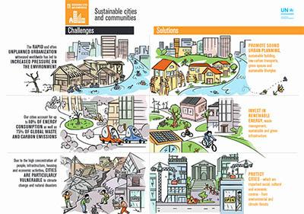
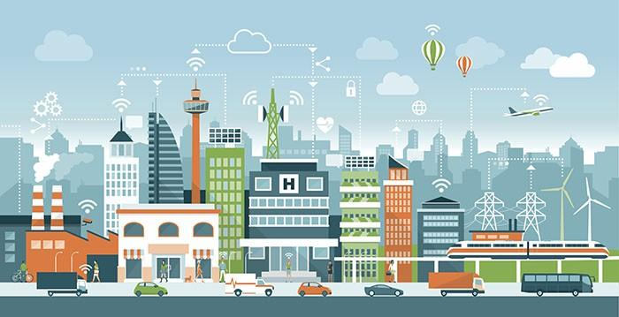
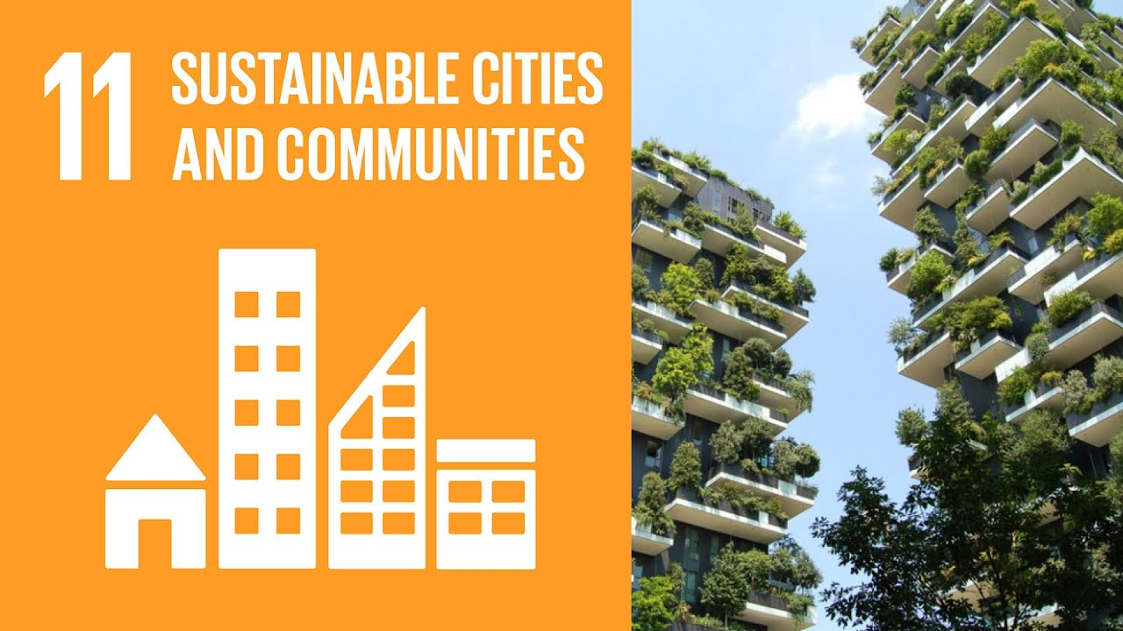

Slide 18
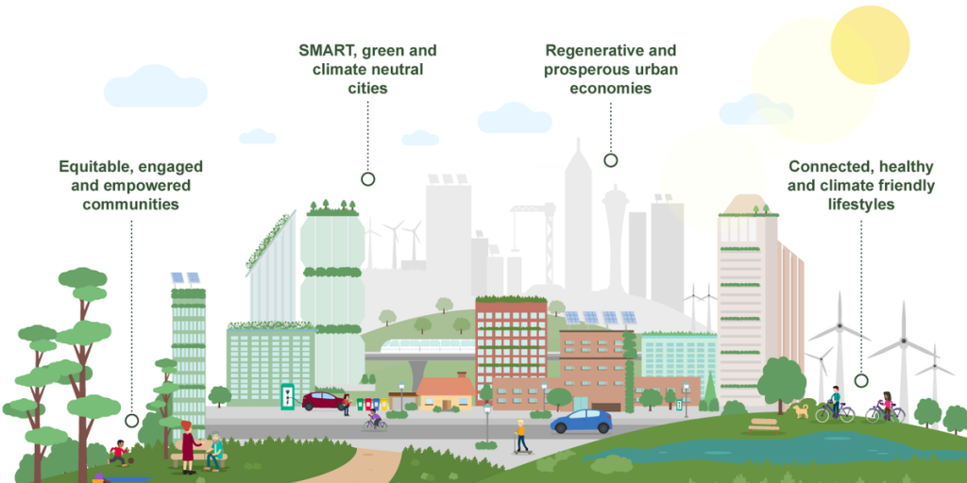
SUSTAINABLE CITIES AND COMMUNITIES
Team: Shingles all the way
Pulkit Varshney Saurabh Parekh
Purva Mhasakar Pratik Thorwe

Slide 19
